Slide 1
Welcome to the 2026 MSPV Technical Session
Dr. Mark Brudnak, Senior Technical Expert, US Army DEVCOM-GVSC
Dr. Vamshi Korivi, Technical Expert, US Army DEVCOM GVSC
Mr. Timothy Lee, Vice President, Intelligent Systems Division, DCS Corporation
Dr. Matt Castanier, Research Mechanical Engineer, US Army DEVCOM GVSC
Mr. Arkady Grunin, Mechanical Engineer, US Army DEVCOM GVSC
Mr. Craig Makens, Vice President of Government Solutions, ThermoAnalytics, Inc.
Ms. Amy DiLella, Technical Specialist, PA&T, US Army DEVCOM GVSC
Dr. Wesley Colley, Senior Fellow, Torch Technologies
Dr. Daniel Carruth, Associate Director, Center for Advanced Vehicular Systems, Mississippi State University
Ms. Sarah Hanania, Administrative Tech, US Army DEVCOM GVSC

Slide 2
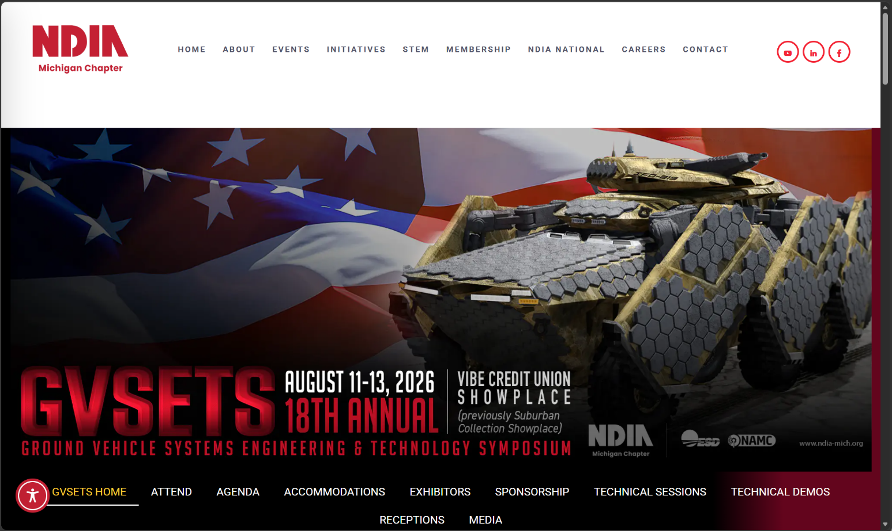
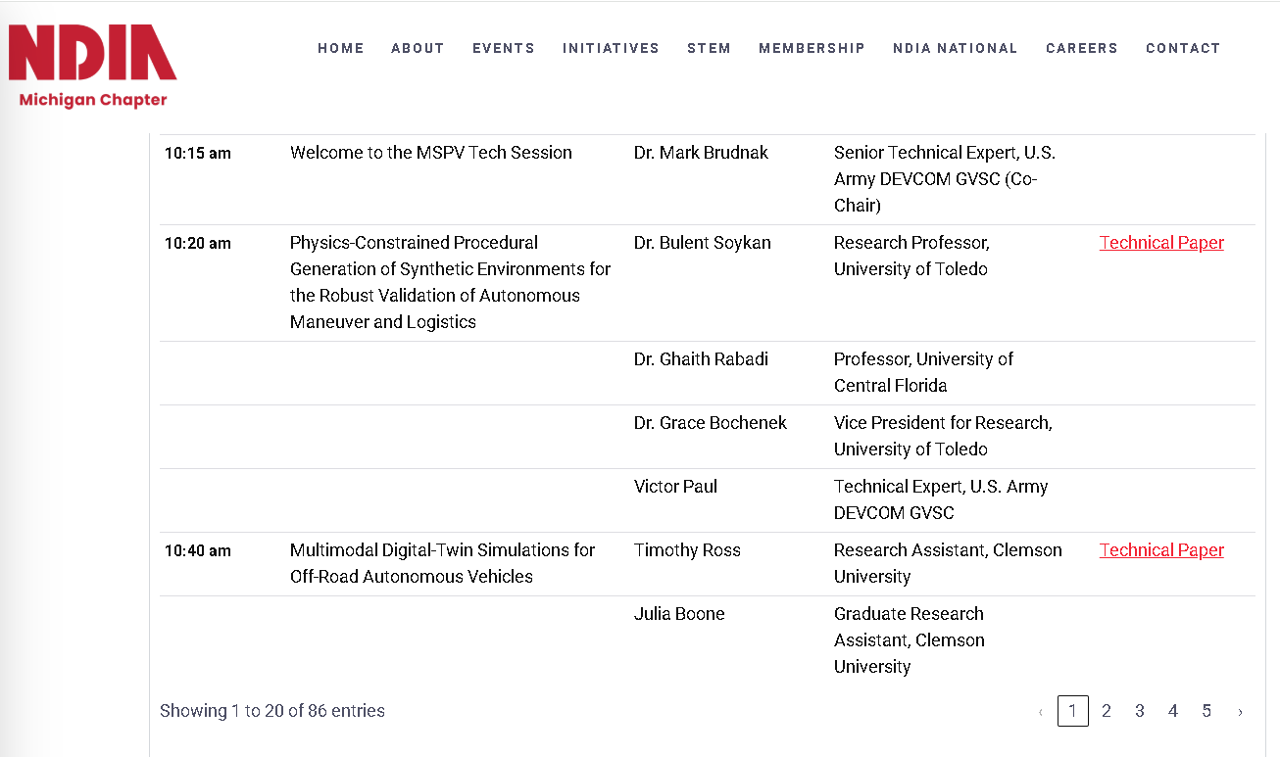
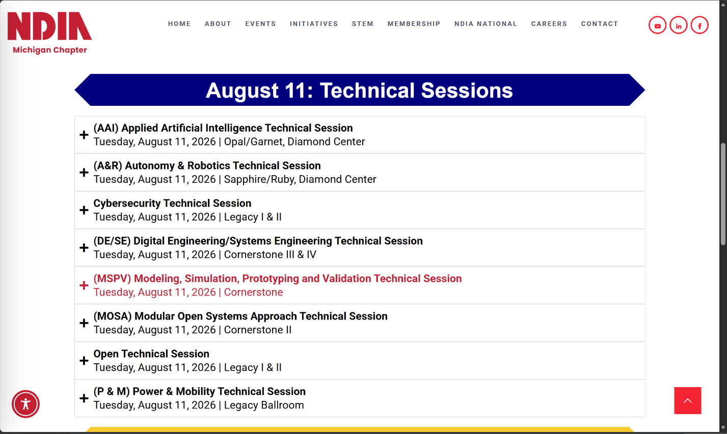

2026 MSPV Agenda / Papers

Slide 3

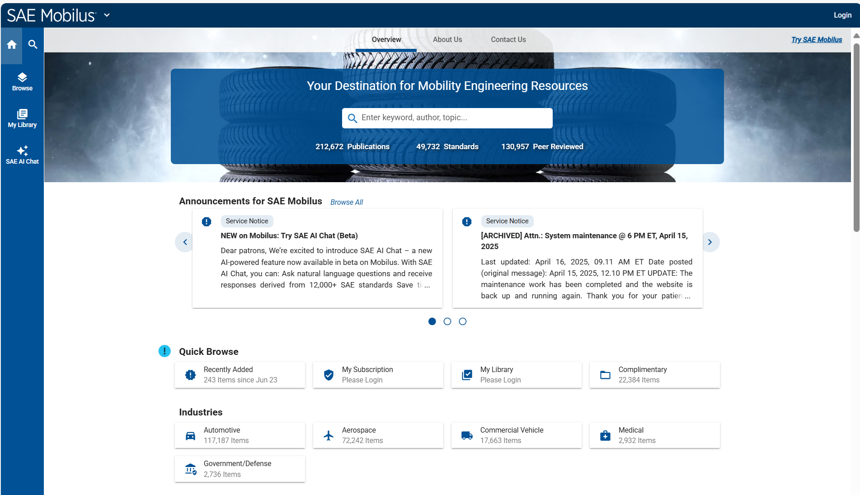
2009 – 2026 SAE Paper Access
https://saemobilus.sae.org/

Slide 4
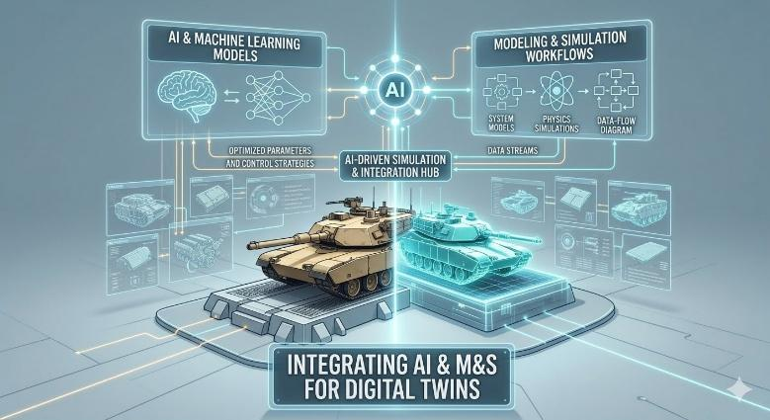
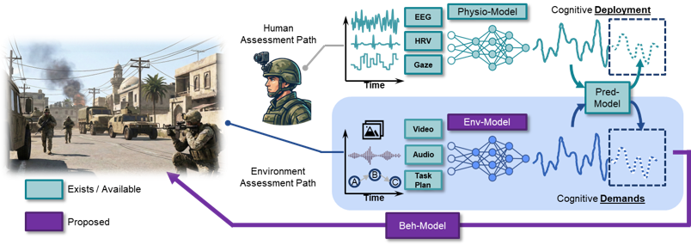

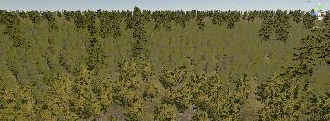
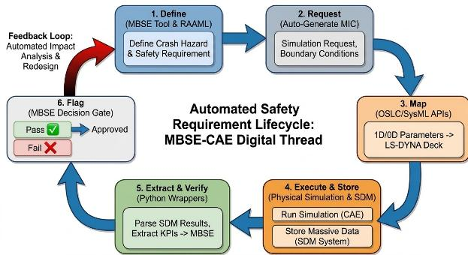
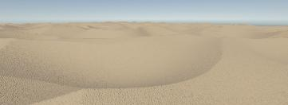
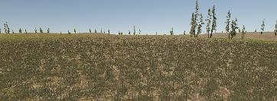

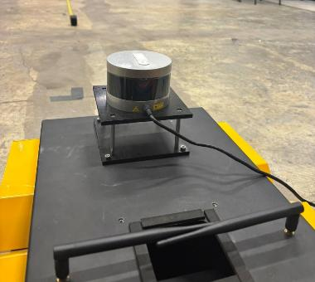
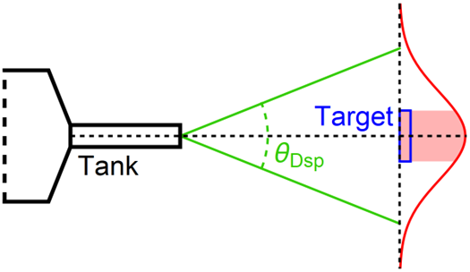
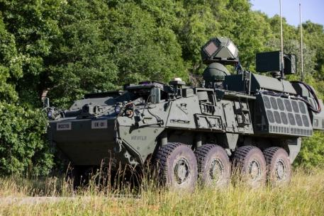
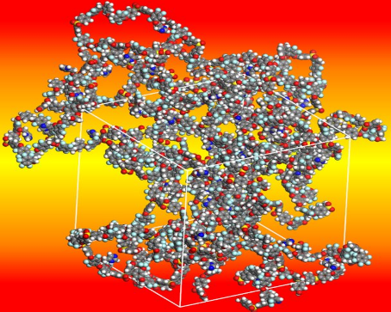
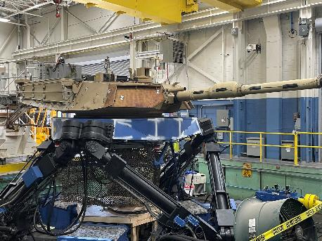
Day’s Agenda
Physics-Constrained Procedural Generation of Synthetic Environments for the Robust Validation of Autonomous Maneuver and Logistics
Dr. Bulent Soykan - Research Professor, University of Toledo
Panel: AI Enabled M&S
Moderator: Dr. Joseph O'Bruba - Data Scientist, U.S. Army DEVCOM GVSC
The Cost of Disruption: Analyzing the Impact of New Tasks on Time-Evolving Cognitive Activity
Dr. Stephen Gordon - Operations Manager, DCS Corporation
Multimodal Digital-Twin Simulations for Off-Road Autonomous Vehicles
Timothy Ross - Research Assistant, Clemson University
Crew Optimization and Augmentation Technologies (COAT) Soldier Touch Point 5 (STP5) Field Experiment
Ryan Wood - Technical Specialist, U.S. Army DEVCOM GVSC
Integrating MBSE with High-Fidelity Crash Simulation
Patrick Rye - Doctoral Candidate, Colorado State University / Propulsion Virtual Performance Integration Manager, General Motors
Comparative Evaluation of CAD Systems as Engineering Design Architectures
Katelynn Hughes - Graduate Research Assistant, Clemson University
Intelligent Optimization Simulation Framework for Test and Evaluation of Autonomous Systems
Dr. Alberico Menozzi - Principal Research Scientist , Novus LLC
Pitfalls in High Stakes Environmental Chamber Testing For Transparent Armor
Brendon S. Busch - BS/MS Engineering Student, Rochester Institute of Technology
Streamlined Model Composition for OneSAF Use in Rapid Trade Study Data Collection and Analysis
Maxwell Jorgensen - Software Design Engineer, Torch Technologies
Parametric Screening of Hybrid Powertrain Architectures for High-Energy Laser Vehicles: Application to Foxhound and Boxer
Wiktor Dotter - CEO & Founder, Powersize Technologies Ltd
(WO) A Standardized Mission Profile and Rapid Architecture Screening Methodology for Hybrid-Electric Tactical Wheeled Vehicles
Rupert Tull de Salis - Researcher, ZeBeyond Ltd
Atomistic Molecular Dynamics Study of Linear and Branched Imidazole-Functionalized Polymers
Sujith Ganta - Graduate Student, Central Michigan University (CMU)
Motion Approach for Turret System Physical Simulation
Victor Paul - Technical Expert, U.S. Army DEVCOM GVSC

Slide 5


AI Enabled M&S
Moderator: Dr. Joseph O'Bruba - Data Scientist, U.S. Army DEVCOM GVSC
Gerald Byrd - Digital Engineering Architect, U.S. Army Capability Program Executive (CPE) Ground - Combat Platforms
Ricardo J. Escobar - Chief Engineer for Embedded Training, CPE Simulation, Training, Test, & Threat (ST3)
Tim Palmer - Chief Engineer of the Systems, Analysis and Simulation (SAS) Group, Torch Technologies
Greg Harte - Senior Principal Consultant-Simulation & AI, Siemens Digital Industries Software
Craig Makens - Vice President Business Development and Partnerships, ThermoAnalytics, Inc.
Dr. Dan Negrut - Bernard A. and Frances M. Weideman Professor, Department of Computer Science, University of Wisconsin
#3318302

Slide 6


Slide 7
10:20 am
Physics-Constrained Procedural Generation of Synthetic Environments for the Robust Validation of Autonomous Maneuver and Logistics
Dr. Bulent Soykan - Research Professor, University of Toledo
Dr. Ghaith Rabadi - Professor, University of Central Florida
Dr. Grace Bochenek - Vice President for Research, University of Toledo
Victor Paul - Technical Expert, U.S. Army DEVCOM GVSC

Slide 8
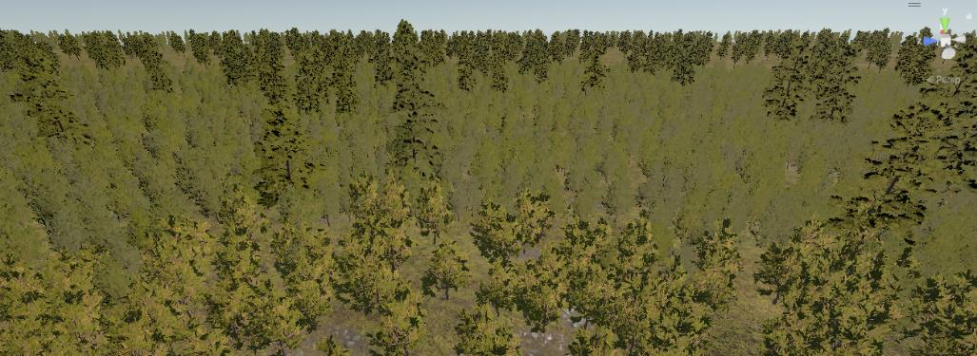
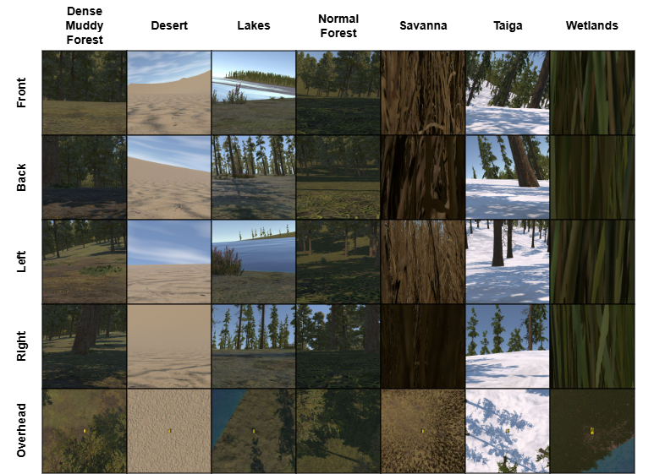
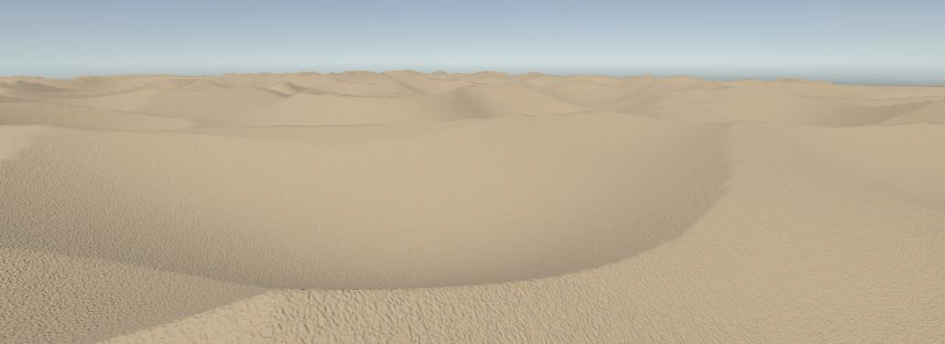
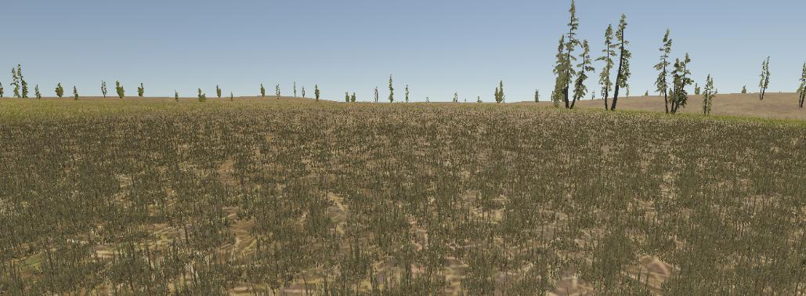
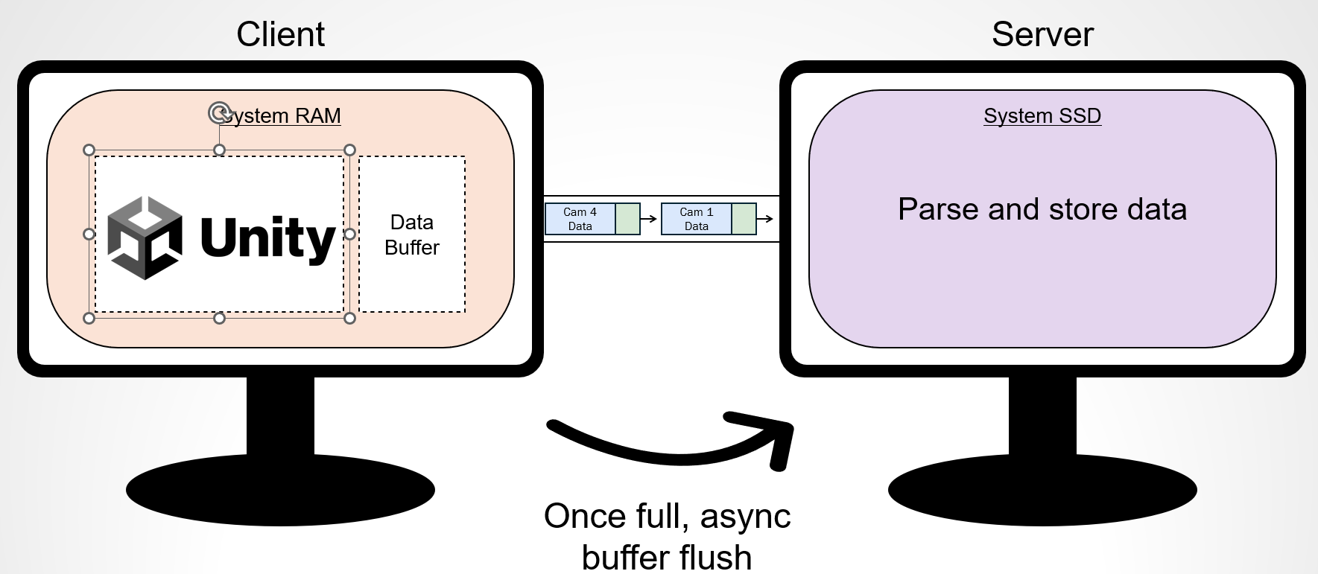
10:40 am
Multimodal Digital-Twin Simulations for Off-Road Autonomous Vehicles
Timothy Ross - Research Assistant, Clemson University
Julia Boone - Graduate Research Assistant, Clemson University
Dr. Fatemeh Afghah - Associate Professor of Electrical and Computer Engineering, Clemson University

Slide 9
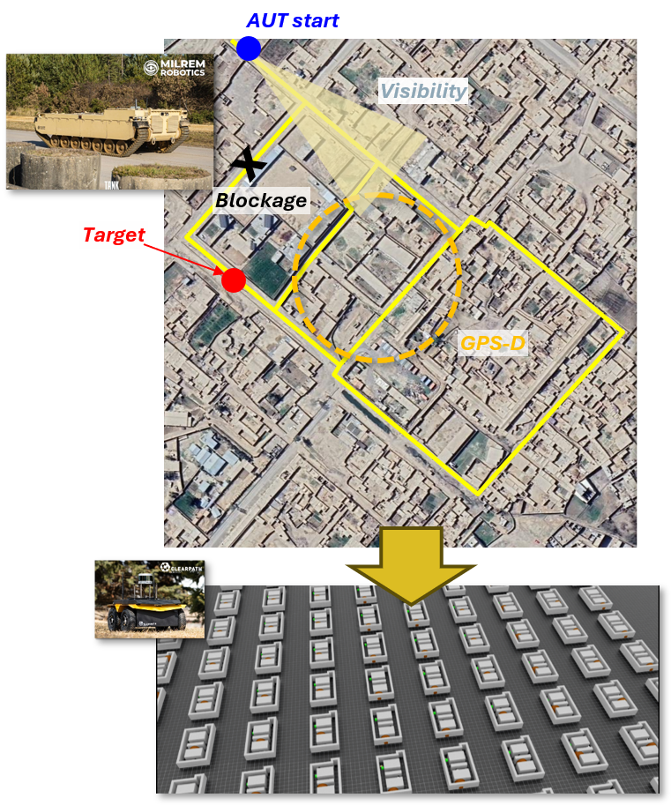
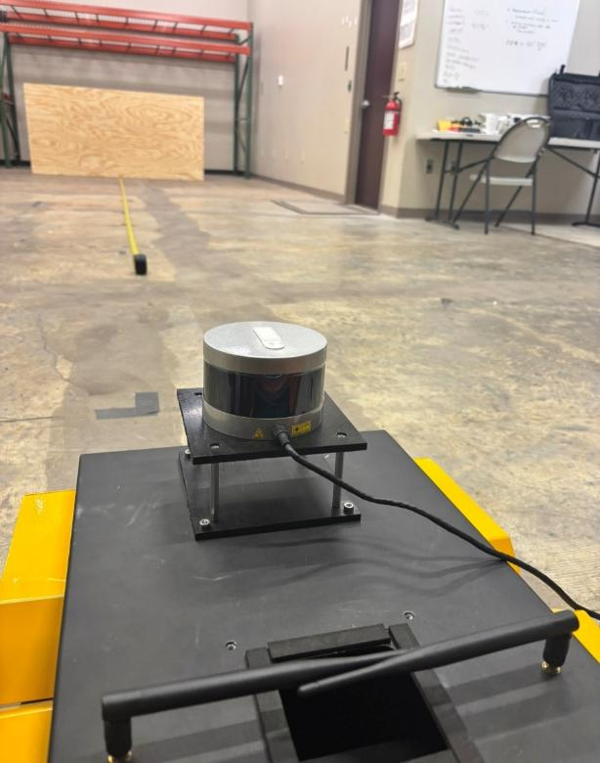
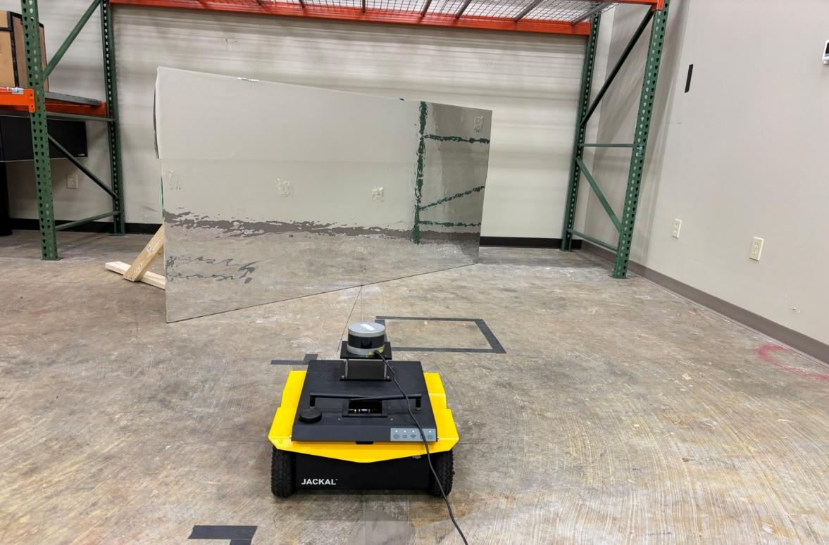
11:00 am
Intelligent Optimization Simulation Framework for Test and Evaluation of Autonomous Systems
Dr. Alberico Menozzi - Principal Research Scientist , Novus LLC
Dr. Stephen Snarski - Technical Fellow, Modern Technology Solutions, Inc.
Brandon Persons - Robotics Engineer, Persons Industries
David Lazar - Senior Principal Engineer, Modern Technology Solutions Inc
Noel Khan - Senior AI/SW Engineer, Eight Queens

Slide 10
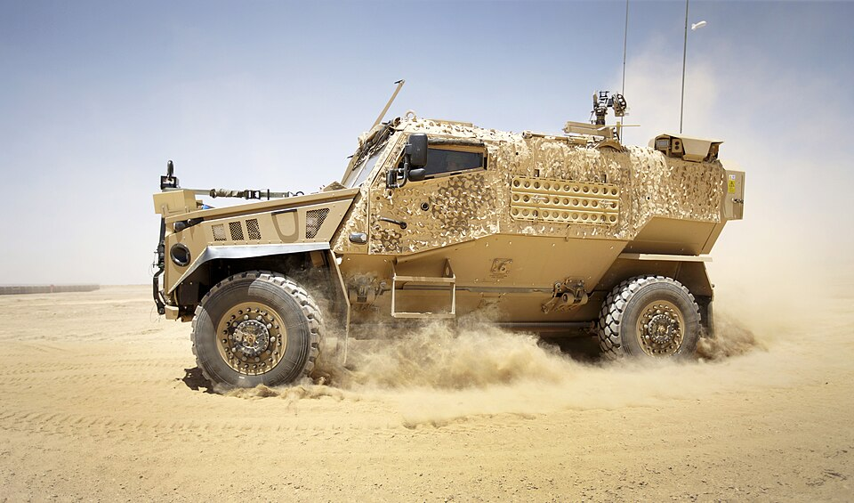
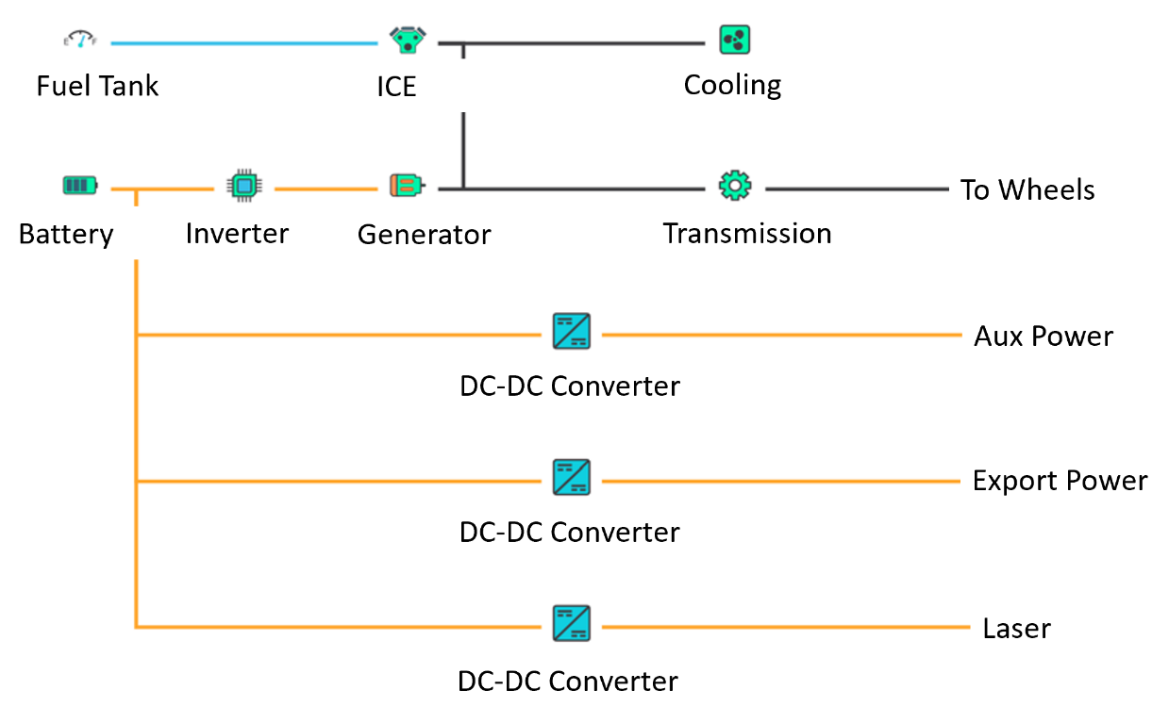

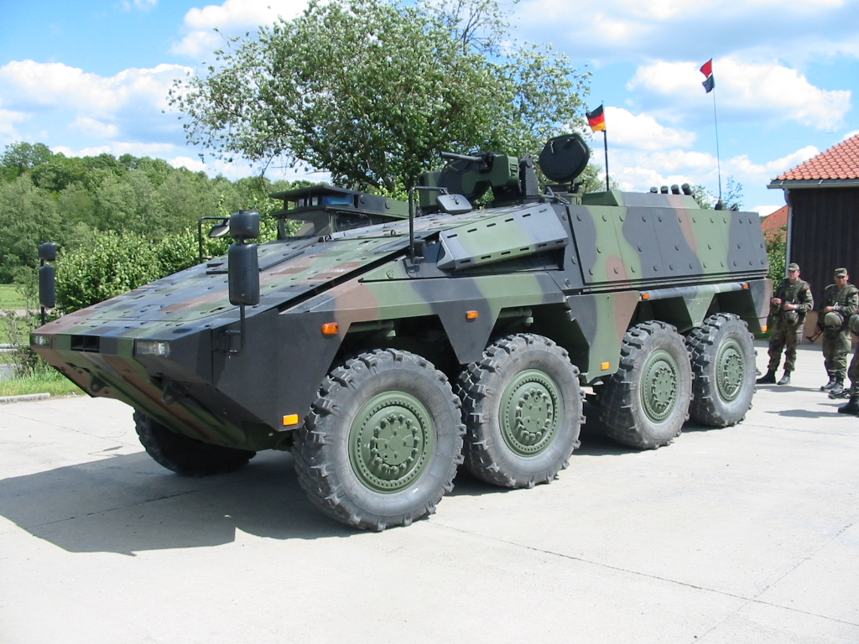
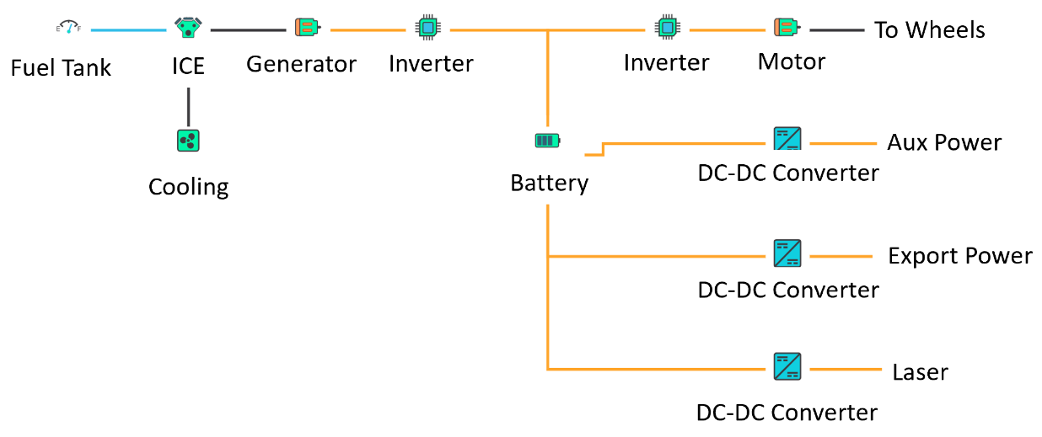
11:20 am
Parametric Screening of Hybrid Powertrain Architectures for High-Energy Laser Vehicles: Application to Foxhound and Boxer
Wiktor Dotter - CEO & Founder, Powersize Technologies Ltd
Rupert Tull de Salis - Researcher, Powersize Technologies Ltd

Slide 11
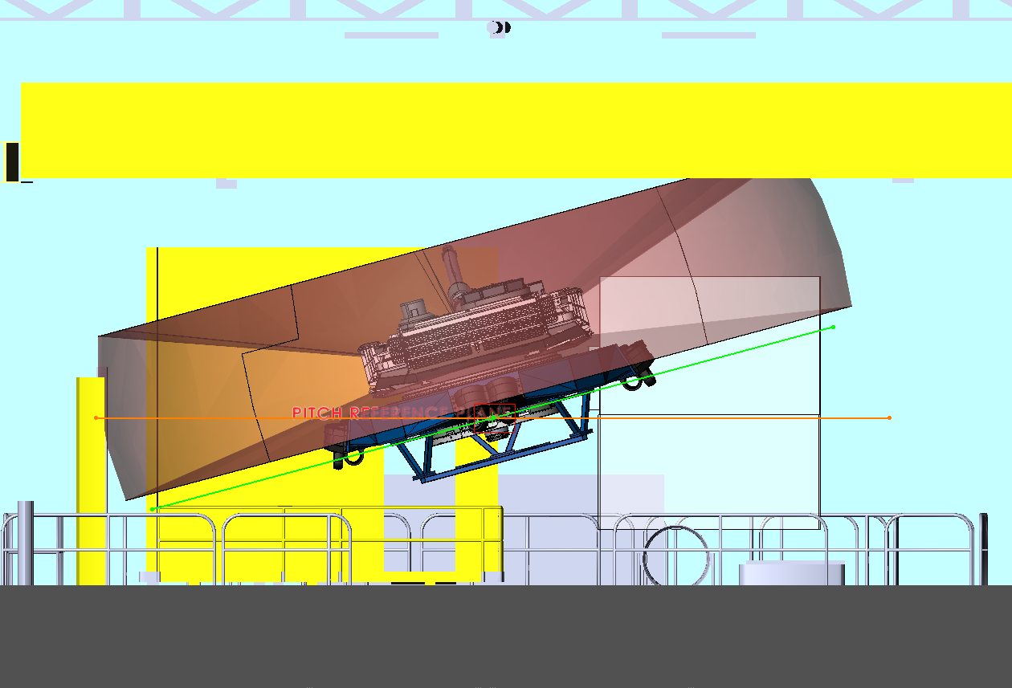
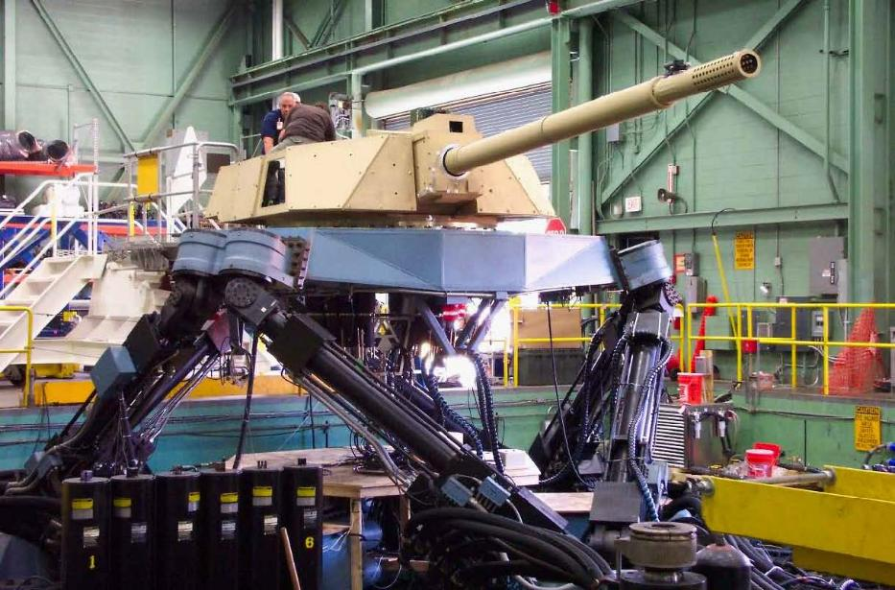
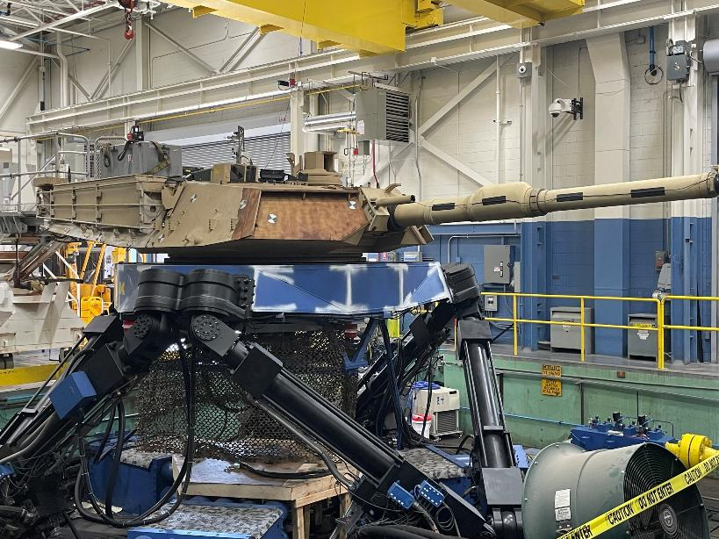
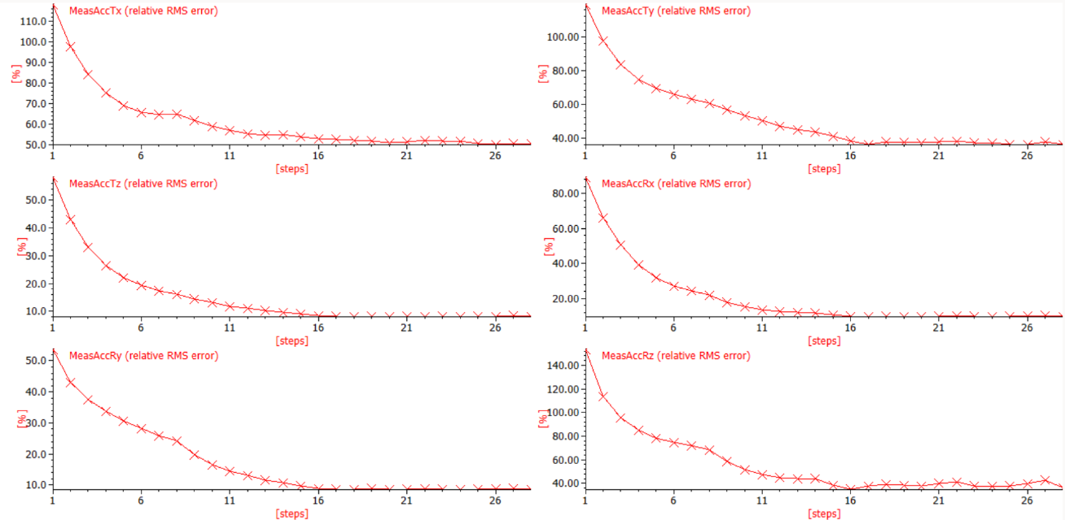
11:40 am
Motion Approach for Turret System Physical Simulation
Victor Paul - Technical Expert, U.S. Army DEVCOM GVSC
Andrew Hoelscher - General Engineer, U.S. Army DEVCOM GVSC
Ahmed Tiguert - Electrical Engineer, DCS Corporation
Harry Zywiol, Jr. - Electrical Engineer, DCS Corporation

Slide 12
1:20 pm
Panel: AI Enabled M&S
Moderator: Dr. Joseph O'Bruba - Data Scientist, U.S. Army DEVCOM GVSC
Gerald Byrd - Digital Engineering Architect, U.S. Army Capability Program Executive (CPE) Ground - Combat Platforms
Ricardo J. Escobar - Chief Engineer for Embedded Training, CPE Simulation, Training, Test, & Threat (ST3)
Tim Palmer - Chief Engineer of the Systems, Analysis and Simulation (SAS) Group, Torch Technologies
Greg Harte - Senior Principal Consultant-Simulation & AI, Siemens Digital Industries Software
Craig Makens - Vice President Business Development and Partnerships, ThermoAnalytics, Inc.
Dr. Dan Negrut - Bernard A. and Frances M. Weideman Professor, Department of Computer Science, University of Wisconsin
#3318302

Slide 13
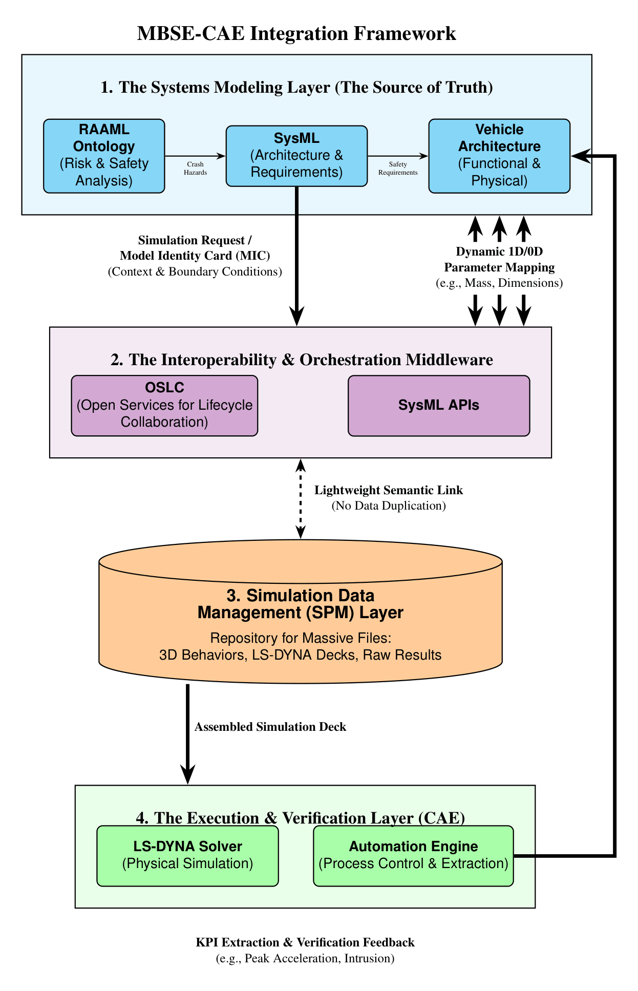
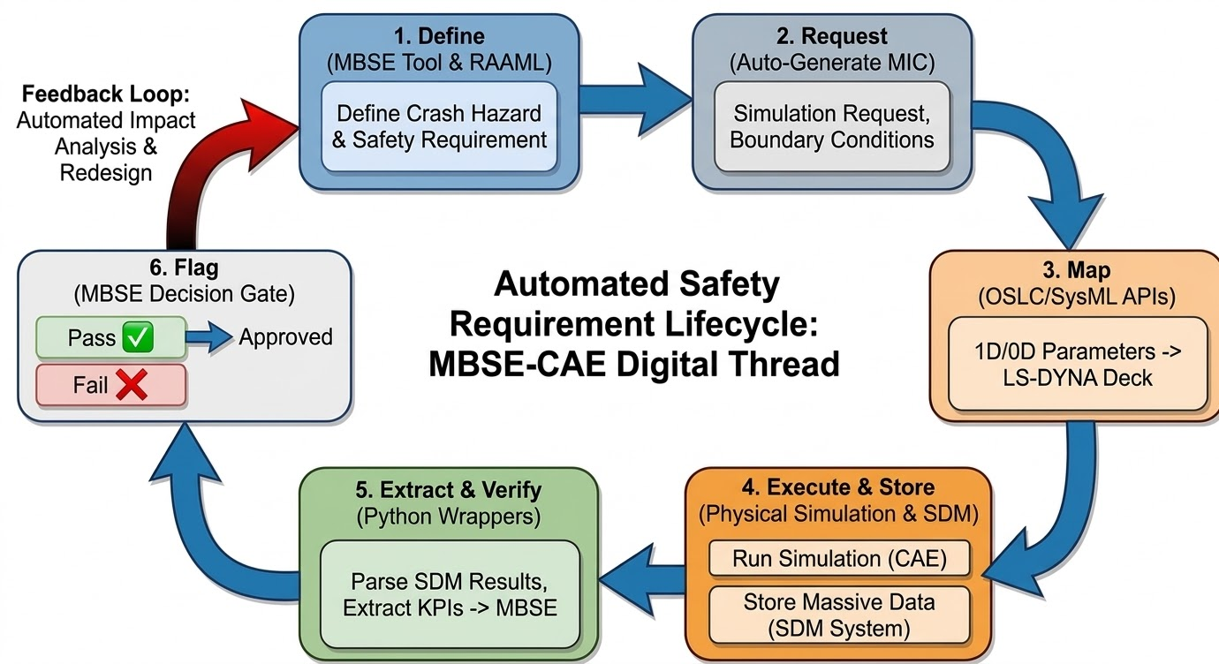
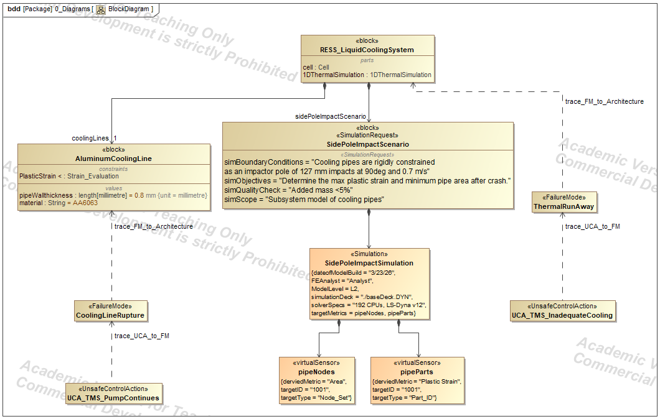
2:00 pm
Integrating MBSE with High-Fidelity Crash Simulation
Patrick Rye - Doctoral Candidate, Colorado State University / Propulsion Virtual Performance Integration Manager, General Motors

Slide 14
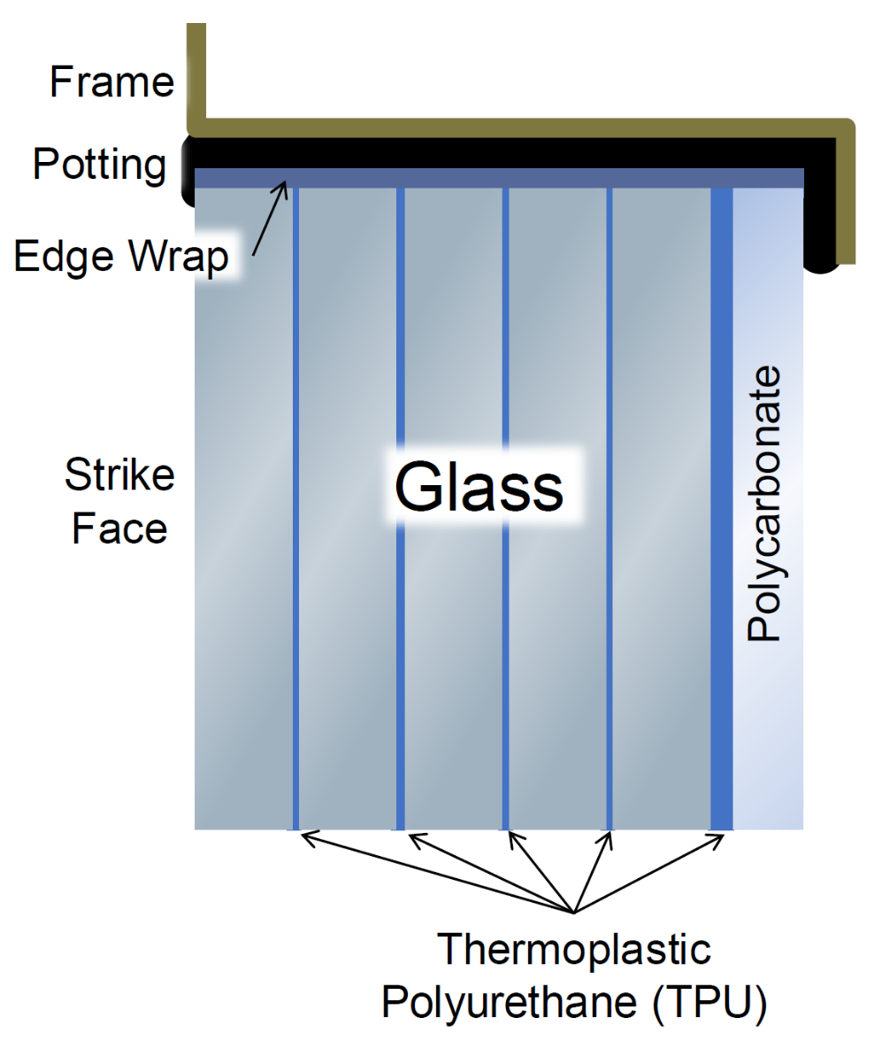
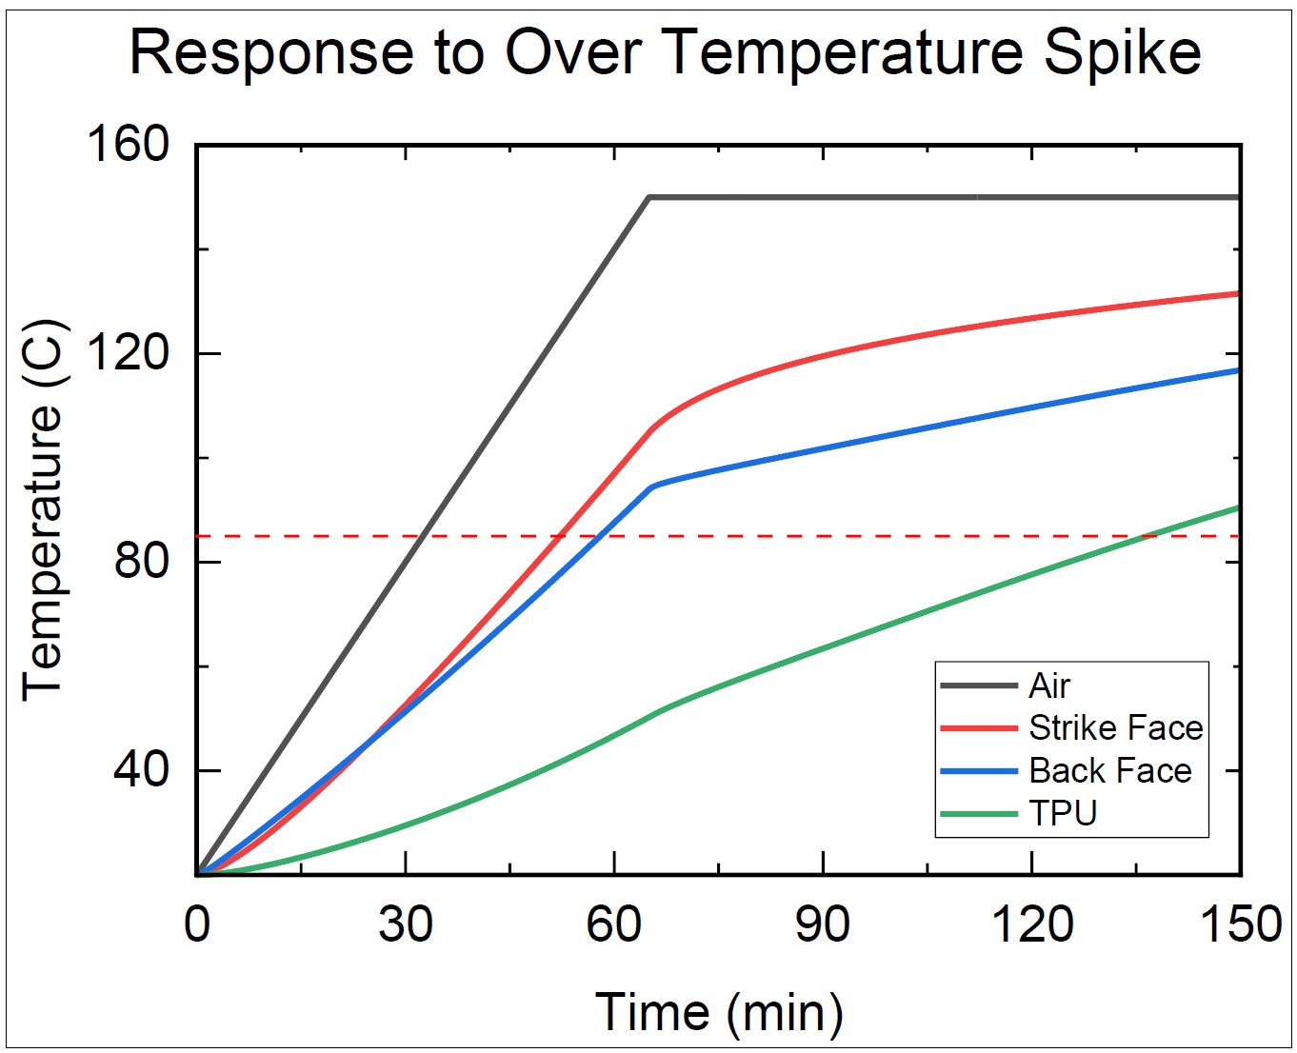
2:20 pm
Pitfalls in High Stakes Environmental Chamber Testing For Transparent Armor
Brendon S. Busch - BS/MS Engineering Student, Rochester Institute of Technology
Christopher T. Key - Senior Principal Engineer, Applied Physical Sciences
Matthew J. Magner - GVSP Technical Specialist for Transparent Armor, U.S. Army DEVCOM GVSC
Kevin A. Brown - Senior Survivability Engineer, SURVICE Engineering
Dr. Marriner H. Merrill - Associate Professor, RIT National Technical Institute for the Deaf

Slide 15
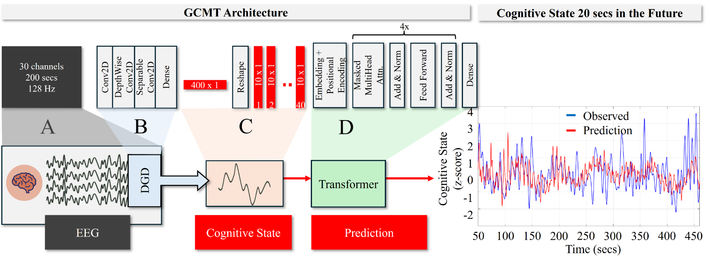
3:30 pm
The Cost of Disruption: Analyzing the Impact of New Tasks on Time-Evolving Cognitive Activity
Dr. Stephen Gordon - Operations Manager, DCS Corporation
Dr. Jonathan Touryan - Branch Chief and Senior Scientist, U.S. Army DEVCOM Army Research Laboratory

Slide 16
3:50 pm
Crew Optimization and Augmentation Technologies (COAT) Soldier Touch Point 5 (STP5) Field Experiment
Ryan Wood - Technical Specialist, U.S. Army DEVCOM GVSC
Rachel Anderson - Human Factors Engineer, U.S. Army DEVCOM GVSC
Andrew Hoelscher - Mechanical Engineer, U.S. Army DEVCOM GVSC
Jeffrey Schultz - Lead Engineer, U.S. Army DEVCOM GVSC
Victor Paul - Technical Expert, U.S. Army DEVCOM GVSC
Dr. Alexander Reid - Human Factors Engineer, DCS Corporation
Steven Ratka - Branch Chief, U.S. Army DEVCOM GVSC
Dr. Kaitlyn Roose - Human Factors Engineer, DCS Corporation
Dr. Lauren Grant - Data Scientist, DCS Corporation
Sumit Shrestha - Data Scientist, DCS Corporation

Slide 17
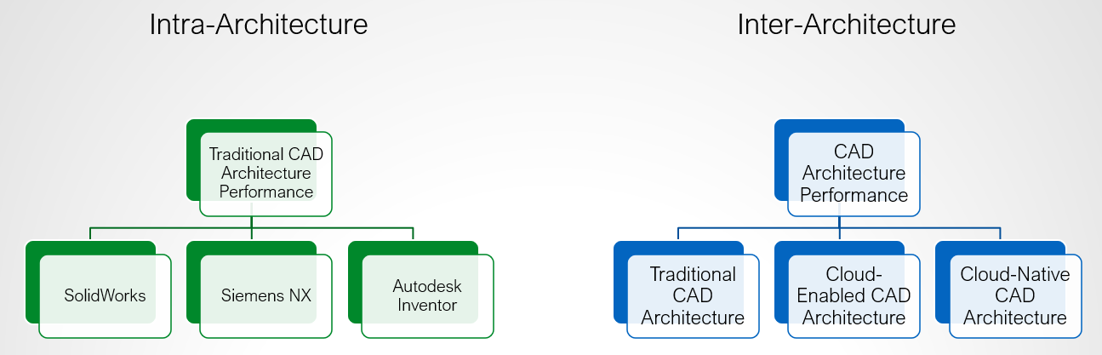

4:10 pm
Comparative Evaluation of CAD Systems as Engineering Design Architectures
Katelynn Hughes - Graduate Research Assistant, Clemson University
Emily Petty - Graduate Research Assistant, Clemson University
Dr. Gregory Mocko - Associate Professor, Clemson University

Slide 18

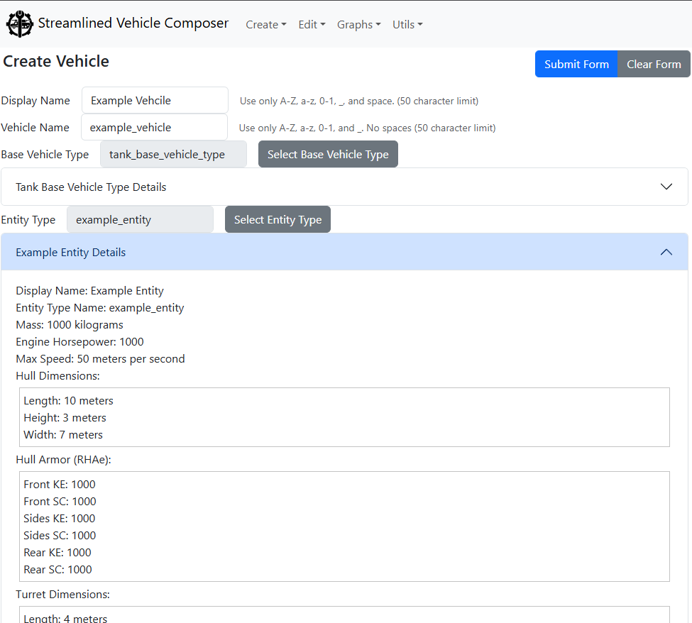
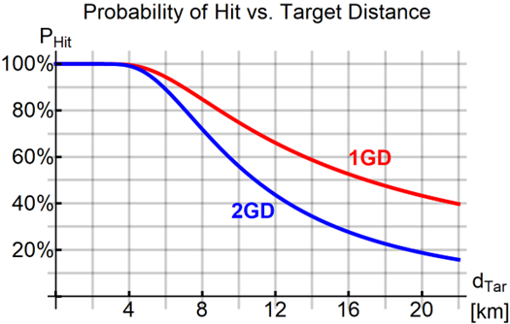
4:30 pm
Streamlined Model Composition for OneSAF Use in Rapid Trade Study Data Collection and Analysis
Maxwell Jorgensen - Software Design Engineer, Torch Technologies
Dr. Oleg Sapunkov - Mechanical Engineer, U.S. Army DEVCOM GVSC
Bradshaw Roberts - Software Design Engineer, Torch Technologies

Slide 19
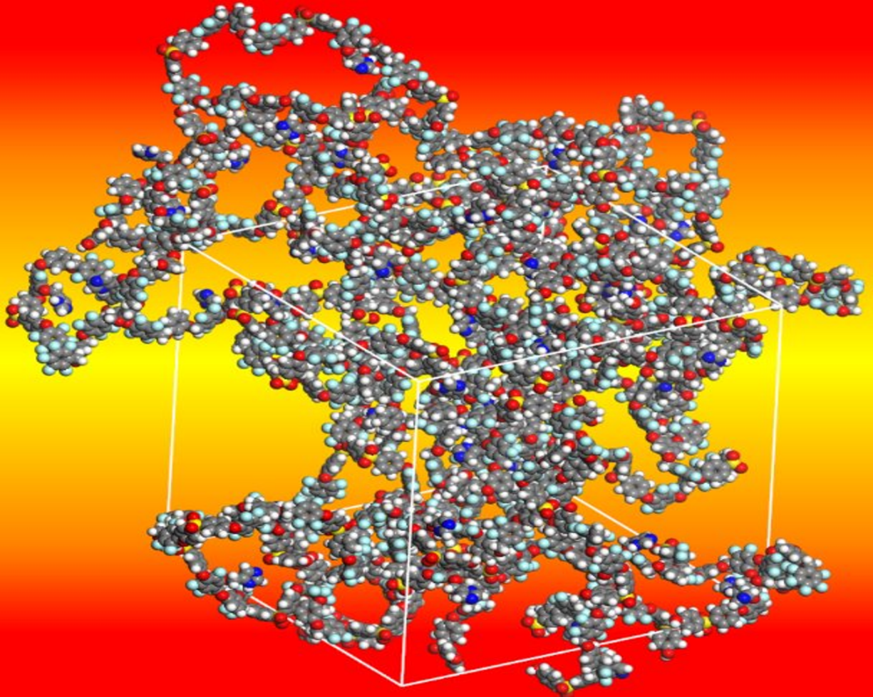
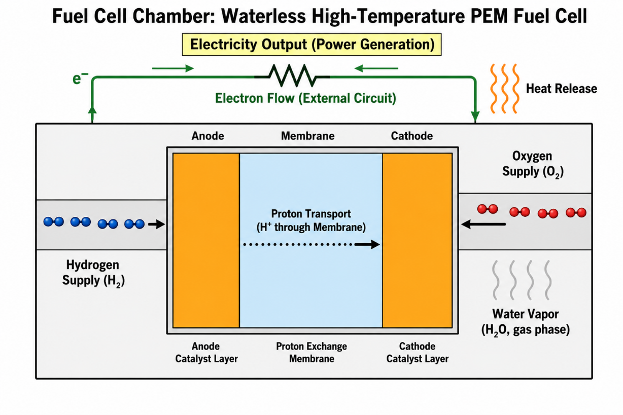
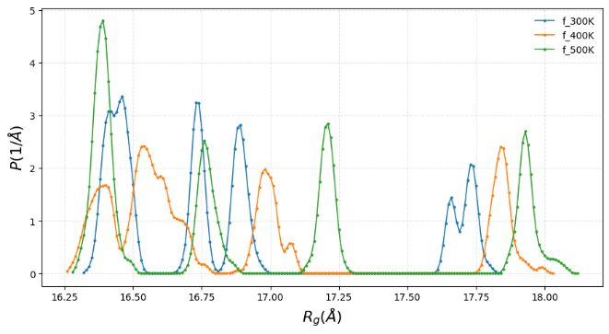
4:50 pm
Atomistic Molecular Dynamics Study of Linear and Branched Imidazole-Functionalized Polymers
Dr. Axel Mellinger - Professor of Physics, CMU
Sujith Ganta - Graduate Student, Central Michigan University (CMU)
Twaha Alim - Research Student, CMU
Dr. Leela Rakesh - Professor of Mathematics, CMU
Dr. Anja Mueller - Professor of Chemistry, CMU
Dr. Theodore Burye - Solid Oxide Fuel Cell (SOFC) Subject Matter Expert, U.S. Army DEVCOM GVSC
Dr. Talia Sebastian - Deputy Chief Scientist, U.S. Army DEVCOM GVSC

Slide 20
5:15 pm

